Slide 1
{Resilience, Availability and Disaster Recovery}

Slide 2
General Approach

Slide 3

Define the problem
Common industry terms
RTO – Recovery Time Objective
RPO – Recovery Point Objective
MTBF – Mean Time Between Failures
MTTR – Mean Time to Recovery
A contract with your users and customers
SLA – Service Level Agreement
Perception and Reputation

Slide 4
A resilient & available architecture
Could you list every component in the solution, along with it’s dependencies and sub-components?
Could you draw a diagram of those components – i.e. your solution architecture on a whiteboard or piece of paper, marking key components ?
Now could you annotate that diagram with performance and resilience data, i.e. Single points of failure and typical performance bottlenecks in day to day usage?
Can you indicate where those components are geographically located on a map and if data is replicated elsewhere, indicate the mirrored region and the methodology of data movement / sync / mirroring etc?
Can you show the entry point into your solution for a customer / end user (there may be multiple entry points) - i.e. which services are considered the 'front' of the stack - do the same on the geo map.
Can you trace a path through the call stack of the application from that front end, stepping through each component used and region where data transits ?
Understand the inter-dependencies between services inside and outside your solution – and document them.

Slide 5
Azure Services

Slide 6
Azure Service Availability
Service | Monthly Uptime % | Specifics
Virtual Machines | 99.95% or 99.9% | Two or more instances, or single instance on premium storage
App Service | None or 99.95% | No SLA for apps deployed in the free or shared tiers
Service Fabric | Per underlying resource | Service Fabric is a free service with no specific SLA, based on underlying resource
Storage | 99.99%, 99.9% or 99% | SLA depends on geo, local or zone redundancy and storage tier
SQL Database | 99.99% | SLA is across the deployment options, excluding retired
DocumentDB | 99.99%
Azure Active Directory | None or 99.9% | No SLA on free tier, SLA on all other tiers.
(User Minutes - Downtime) / User Minutes * 100 = monthly uptime %
99% = 403 minutes/month
99.99% = 4 minutes/month
As of March 2017
https://azure.microsoft.com/en-gb/support/legal/sla/summary/

Slide 7
Azure Solution Resiliency
Your solution Azure SLA is the product of the service SLAs:
Web Site hosted in App Service = 99.95%
Azure SQL Database = 99.99%
Storage = 99.9%
Solution SLA = 99.84%
Your overall solution SLA needs to take account of *your* activity:
Your application’s reliability and availability
Deployment and DevOps activities
Support and Recovery Operations
‘Unplanned’ activities
…

Slide 8



Using Azure – Thinking Resilience
From an architecture and design perspective, what are the options for availability and resilience?
Web Front-End
How can issues effecting an Azure region be avoided and recovered from?
SQL Database
What are the cost implications of my availability and resilience choices?
Storage
Where can I get more detail?

Slide 9
Using Azure – Storage
The application is using storage for image content and archiving data for future analysis.
Image content
Archive Data
High user impact, high read volume, needs high availability
Not immediately useful but has longer term value that could be monetised
HOT Read Access Geo Redundant Storage (RAGRS – HOT)
COOL Locally Redundant Storage (LRS – COOL) with manual backup
Low cost to access data but higher cost to store due to HOT, automatically copied to another region which can be read by the application
Very low cost storage due to COOL, may not be available occasionally but manually backed up on a monthly basis
https://azure.microsoft.com/en-gb/pricing/details/storage/blobs/

Slide 10
Using Azure – SQL Database
The application is using Azure SQL database to store transaction data. The application is non functional without the database and information loss has high impact.
The impact to users if the database is not present has selected active geo-replication to a single secondary region in Europe. Cost concerns mean lower secondary performance.
In the event of complete loss of online capability, standard tier service offers 35 days of backups with < 1 hour’s lost data. We can restore from the replicated database.
Performance analysis has selected the standard tier service.
https://azure.microsoft.com/en-gb/pricing/details/sql-database/

Slide 11
Using Azure – App Service
The application is using ASP.NET to serve a web UI and a REST service layer. Both UI and service layer need to be running for the application to be functional.
Performance analysis has determined two instances of our web tier. This does not benefit our resiliency, there is a still a concern over user impact.
A replica of the web tier will be hosted in a second data centre, matching the location of our geo-replicated SQL database. We need to handle the second deployment as part of our DevOps. It will be scaled down to conserve cost.
Traffic manager will be used to allow users to switchover to the replica website. This will be configured to automatically switch over when failure is detected.
https://azure.microsoft.com/en-gb/pricing/details/app-service/

Slide 12

Using Azure – Active/Passive
Our design choices have led to an Active/Passive deployment model for our application.
UK South
West Europe

Slide 13
Demo
Kicking the application

Slide 14





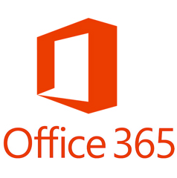


Using Azure – Other Models
IaaS – Azure Virtual Machine, Storage, Network SLA
Availability Sets, Managed Disks, Multi- site/region.
Software availability and resilience concerns.
PaaS-ier – Service Fabric, Containers, Functions. Pass-through SLA
Higher decomposition, reliance on PaaS orchestrators
SaaS – Direct SLA with the service provider or your on-premises investments. These are a dependency for your application and should be part of your planning.

Slide 15
Resilience
Single-region deployment in azure
Some customers believe that Azure automatically deals with scalability and resiliency across regions.
Customers should plan for an outage of services in a particular region and failover where necessary
lack of strategy for resilience within services
Some Azure Services have functionality built in, to deal with availability.
Customers should be aware of these services, e.g. Traffic Manager, or Service Bus Paired Namespaces, Storage GRS vs RA-GRS (and failover)
Ignore third party dependencies that could impact your service
Most solutions have included dependencies outside of Azure.
Customers should ensure that a graceful degradation occurs, for components inside Azure and outside.
ignore single points of failure
Some solutions we have seen have single points of failure in their solution. If this goes down, your application will be down.
Customers should run all tiers of their application in a resilient manner if the SLA requires it.

Slide 16
Information and Processes

Slide 17
Plan for recovery
The application has been architected for resilience but your people and processes need to be planned.
The major incident response plan (MIRP)
Who is monitoring for failure?
Who needs to be alerted when failure occurs?
Does engineering have the correct access/permissions?
How will troubleshooting information be captured?
How would you redeploy the application from scratch?
How do you contact your suppliers (including Microsoft)?
Can you categorise and prioritise the severity of the incident?

Slide 18
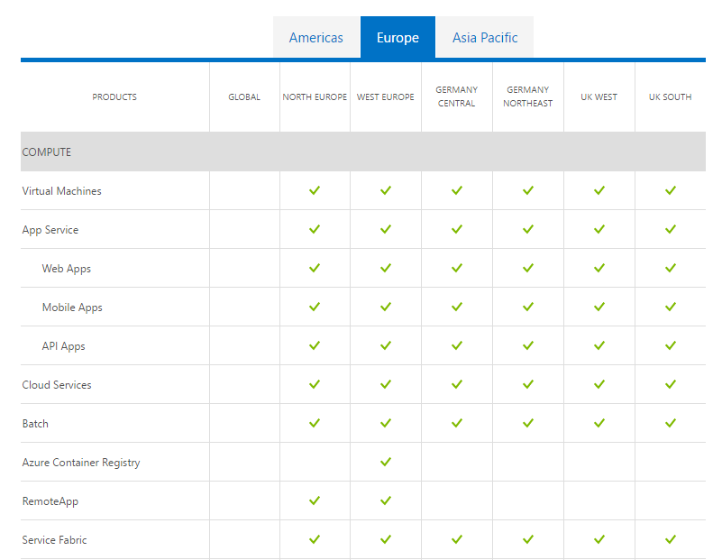
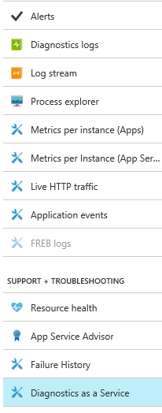
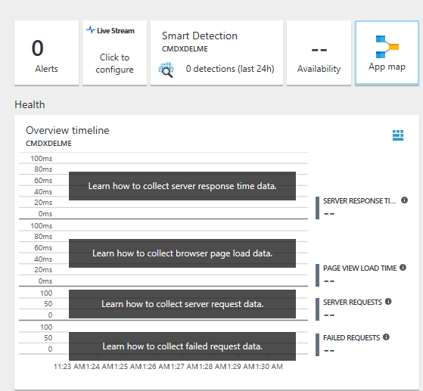
Monitor your applications, use the data
Discover the health of Azure and your application. Use that information to respond and categorise.
Azure status dashboard and
Health Blade
Diagnostics, Logs and Alerts with your service
Application Insights to monitor and diagnose
https://azure.microsoft.com/en-gb/status/

Slide 19
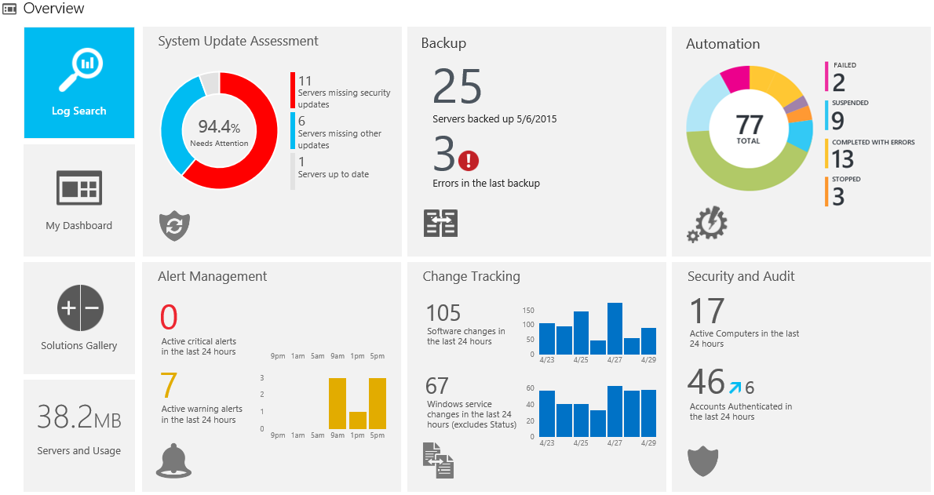
Operational Monitoring
At scale there are tools to build operational processes and insight into your BAU running of applications
Microsoft Operations Management Suite
Third Party Partner Tools and Services
Variety in functionality and price point for your needs and objectives
A tool for end to end IT operations and monitoring of multiple complex application deployments.

Slide 20
Demo
Monitoring the application

Slide 21
Availability and Disaster Recovery
Ignore a major incident response plan
In a number of assessments, customers did not have a Major Incident response plan in place.
Customers should ensure that they have a MIRP in place, clearly defining responsibilities across the solution, escalation protocol and any other necessary processes to follow in a disastrous scenario.
Ignore the need for a data reconciliation strategy
Many solutions are based around the concept of Eventual Consistency and / or multi-region deployment.
When faced with region failover, how do you know that critical data is present and valid in the new region, what was lost from the primary region and may now never arrive in the secondary ?
Fail to test your dr / ha strategy
A number of customers had either an automated Disaster Recovery mechanism or well-documented approach. However, this approach had not yet been tested.
Customers should test their disaster recovery semi-regularly, to ensure that the process is still relevant and that all parties are aware of the required steps.

Slide 22
Resources

Slide 23
Resources
Designing resilient applications for Azure
https://docs.microsoft.com/en-us/azure/architecture/resiliency/
Overview of business continuity with Azure SQL Database
https://docs.microsoft.com/en-us/azure/sql-database/sql-database-business-continuity
Availability and Resiliency Checklists
https://docs.microsoft.com/en-us/azure/architecture/checklist/availability
Azure Monitoring Overview
https://docs.microsoft.com/en-us/azure/monitoring-and-diagnostics/monitoring-overview
Azure Service Level Agreements
https://azure.microsoft.com/en-gb/support/legal/sla/
Azure Support Plans
https://azure.microsoft.com/en-gb/support/plans/

